Slide 1

FORGERY DETECTION IN DIGITAL IMAGES
MIRACLE EDUCATIONAL SOCIETY GROUP OF INSTITUTIONS
(Affiliated to Jawararlal Nehru Technologyy University, Gurajada vizianagaram), Miracle city, Bhogapuram(M), Vizianagaram
Department of Electronics & Communication Engineering
Under the guidance
Mr. Allu Venkateswara Rao
Associate professor
By
XXXX
XXXX
XXXX
1

Slide 2
CONTENTS
Abstract
Motivation of Research
Introduction
Image Forgery Detection Techniques
Framework for splicing detection
Proposed method
Results
Conclusion
Future Scope
References

Slide 3
ABSTRACT
Image splicing detection would have huge impact in various application domains such as, crime investigation and detection, fashion industry, scientific journals, insurance claim processing, law enforcement, medical imaging, surveillance system and many others.
Hence, a new optimized algorithm Generalized Approximate Reasoning based Intelligence Control (GARIC) with regression rules for feature extraction, feature matching and post processing.
It has been implemented with reduced multi-dimensional scaling features to discover the spliced image regions which are blurred, brightness altered and color reduced with different levels.
So that we have developed an optimized deep learning algorithm to detect spliced region effectively. Here, the Action selection network (ASN) is a 5-layer network used to distinguishes the spliced image tampering.
This method is simulated using Python and the results prove the performance of an innovative method. Moreover, the obtained results are compared with recent existing approaches.

Slide 4
Motivation of Research
Images are generally used as major source of information for effective communication, namely digital media, electronic media, military, forensics, science and technology, medical sciences, social media, and so on, and all over the internet.
However, the reliability of image is questionable due to the powerful and low cost image editing technologies which facilitate to acquire and manipulate digital images.
But the development of hacking technologies and other forgery activities can reduce trust among the people regarding authenticity.
4

Slide 5
Motivation of Research
Digital image splicing detection techniques got important in digital image world.
Moreover identification of fake image is difficult because the pasted image is same as the whole image.
Thus, it becomes harder for the human visual system to differentiate between legitimate and forged / manipulated images.
Such type of issues is the motivation to carry out research in this area.
5

Slide 6

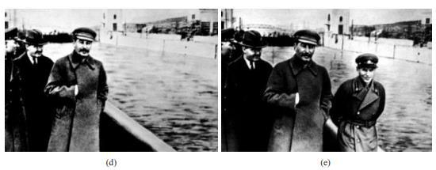
Examples of Forged images
Student leader speaking in front of a map showing a divided India, in which portions of Kashmir and Gujarat were merged to Pakistan but in the original image (g) he is speaking in front of a blank background
A Minister was removed from the original photograph (e) After falling out of favor with Stalin.

Slide 7
Introduction
Digital image manipulation takes part to deform the content of an image in order to accomplish some deceit purposes. Such manipulations are known as forgeries.
The major focus of a digital image forgery or manipulation is to hide an existing object in the image and to create a duplicate or to change the meaning of the original image completely.
The tampered is close resembles to the original image.
Image splicing detection techniques have been developed to ensure whether the image content is modified after it was acquired.

Slide 8

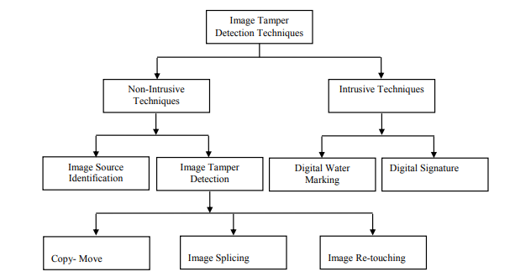



Image Forgery Detection Techniques

Slide 9
Active Forgery Detection
Active authentication requires pre-embedded or pre-extracted information.
Active authentication depends on the digital signature and need an original input image.
In the active approach, the signature that was embedded in the image during image creation is extracted.
This approach is sometimes called “watermarking”.

Slide 10
Passive Forgery Detection
Passive forgery Detection
In contrast to active approach, passive approach is blind and do not require pre-embedded information about input image. Therefore, it does not require watermarking or signatures.
The passive approach checks the authenticity of images from an unknown and uncorrelated image.
Passive approach is categorized into three groups:
Copy-move forgery.
Image splicing.
Image retouching.

Slide 11
Image splicing
Image splicing is executed by hiding a region in an image by
pasting another region over it.
To make the forgery undetectable some form of image
manipulations like scaling, contrast enhancement,
blurring, noise addition, rotation, compression,
reflection etc. might have been applied on the copied region.
This is the hurdle in most of the detection techniques. So it is
crucial in the development a image splice detection technique to
select an image feature to be extracted from the image that is
invariant to any form of manipulations

Slide 12

Example of Splicing

Slide 13
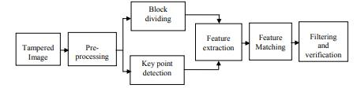
A Framework for splicing detection based on image manipulation

Slide 14
Pre-Processing
Image preprocessing is the initial Step. The motive of this
step is to improve the image by suppressing unwanted
distortions or enhance some important features.
The most popular operations in this preprocessing step
are filtering, image enrichment, trimming, change in DCT
coefficients, RGB to gray scale transformation before
handling the image to feature extraction procedures.
This step is used to improve the computational time by
preparing the image for the next step. This step is application
dependent and optional. According to the requirement of
application different type of processes like color conversion,
low power filtering, dimension reduction are used.

Slide 15
Block-Based Methods
Block-based techniques are generally based on dividing the image into overlapping, circular or rectangular blocks for feature extraction. Feature extraction algorithms are implemented on each segmented image to obtain feature vectors.
The method detects multiple instances of copy-move in a single image but it is not rotation and scale invariant.
The method has lower computational complexity and is effective for high resolution images.

Slide 16
Key-point based Methods
The high computational cost in block-based method leads to the improvement of key-point based methods.
key points are important features in an image that helps to identify the forged part in an image. Key points are computed by scanning the image. Then feature vector is computed for every key point.
Main advantage of key point-based methods are computationally less complexity and invariant under rotation and scaling.
Key point-based feature extraction algorithms are divided in to three categories.
Scale-Invariant Transform (SIFT)
Speed-up Robust Features (SURF)
Harris Corner Points

Slide 17
Feature Extraction
In Block based method, feature vector is computed for each rectangular block but in case of Key-Point feature vector is computed for each key-point in high entropy region of an image.
During feature extraction, features must nullify or avoid repetition in the original image.
Matching
The aim of this step is to find the duplicated blocks based on their feature vectors. This can be done by sorting the vectors and compute the similarity between neighbor’s vectors.
High similarity between two vectors is interpreted as a hint for duplicated blocks.
Euclidean distance, K-d tree, Best-bin first search Lexicographically sorting and are the most common sorting methods that were used.

Slide 18
Filtering
Filtering is used to reduce certain probability of false matches to claim the presence or absence of tampered region. This step is performed in order to group matches that jointly follow a transformation pattern and so reduce superior matches.
Furthermore, matches that originate from the same copy-move action should exhibit similar amounts of translation, scaling and rotation.
Post-processing
The motto of Post processing is needed to remove the isolated blocks. Locating (highlighting) isolated blocks can be done by coloring the copied blocks.
The generally utilized post processing variant gets anomalies by impressing less number of comparative shift vectors between the matches.

Slide 19
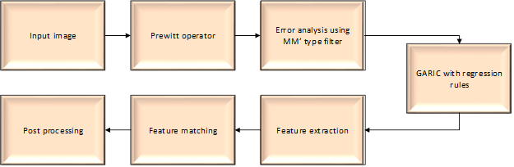
Proposed methodology

Slide 20
Artificial neural network
There are two types of classifiers has been performed
1) Single Layer Artificial Neural Network Classifier
2) Optimized Multilayer with Back Propagation Algorithm In single layer the extracted features are fed into the input layer then the output value is calculated by multiplying the input value with weight. In multi layers It has three layers Input, hidden and output layers

Slide 21
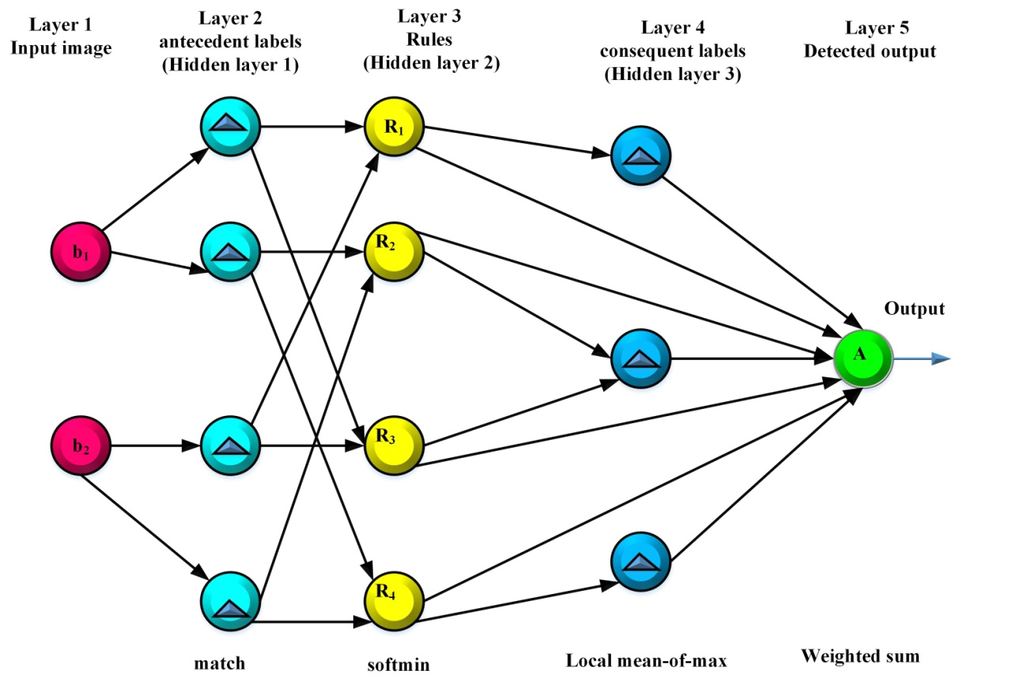
Structure of Artificial neural network (ANN)

Slide 22
Layer 1 represents the input layer with real input image blocks. No computation is done at the nodes.
Here the input images are filtered using pre-processing by removing the unwanted particles in the image.
Layer 2 (first hidden layer ) will have exactly one input and will supply the result to total rules which in utilized to perform the feature extraction.
In this triangular shapes are preferred because it is simple and provided to be sufficient in out comes for particular domain

Slide 23
Layer 3 (second hidden layer) stores the feature extracted images based on the input images. A node in layer 3 represents a rule in the rule base. This node itself performs main operation.
Layer 4 ( third hidden layer) stores the linguistic values of all out put variables. Nodes in this layer represents the matching blocks which can match the images based on consequent labels.
This particular resulting consequent label uses the inputs taken from all rules.
Layer 5 contains the detected output. This layer delivers a continuous output forgery detected output, which is the action selected by ANN.

Slide 24
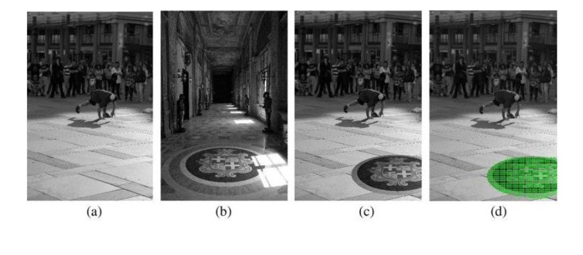
Results:
(a) and (b) are original images
(c) is spliced image
(d) is detected region

Slide 25
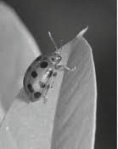
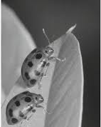
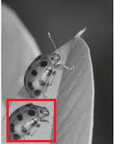

(a) original image​
(b) tampered image
(c) detection of tampered region​
(d) Localization of tampered region​​

Slide 26
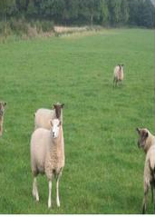

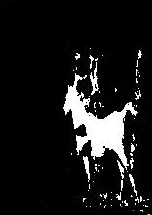
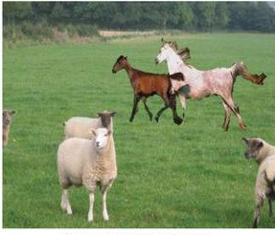
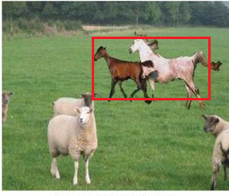
4. Localization of spliced region​​
1. Original images
2. Tampered image
3. Detection of tampered region​​

Slide 27
Result: Table: Accuracy comparison
Methods | Accuracy (%)
Geometry invariants | 79.17
Binary similarity | 93.75
Proposed method | 98.38

Slide 28

Graphical representation of Accuracy

Slide 29
Conclusion
An efficient Deep learning algorithm has been developed based on ANN to discover simple and multiple spliced regions even after some geometric and image distortions.
The Proposed system is based on implementation of Python.
This method has lower computational complexity and high accuracy rate over the existing methods.
We obtained 98.38 accuracy when compared with recent existing approaches.

Slide 30
Future Scope
Illumination distortion is one of the bigger challenges in
splicing detection.
Proposed method shows accuracy up to 98.38% and still
there is a need of developing a robust method to reduce
false matches and improve the accuracy while detecting
spliced image.
Advanced machine learning approaches can be deployed
to classify the spliced image. This splicing detection can
be extended to audio and video splicing detection.
Image retouching can also be addressed in future
research.`

Slide 31
Advantages
Detect forgery in JPEG compressed image
Fast, robust against JPEG compressed and variant
Reduced time complexity, robust against
rotation, scaling and noise.
Reduced feature dimension and improved computational
time
Better accuracy.

Slide 32






Application
Surveillance system
Fashion industry
Law enforcement
Crime investigation and detection
Insurance claim processing
Medical Imaging

Slide 33
REFERENCES
[1] H. Farid, “A Survey of Image Forgery Detection”, Signal Processing Magazine, vol. 26(2), pp: 16–25, 2009.
[2] Gajanan K Birajdar, Vijay H Mankar, “Digital image forgery detection using passive techniques: A survey”, Digital Investigation, Vol.10 (1), pp: 226–245, Elsevier, 2013.
[3] Luo Weiqi, Qu Zhenhua, Pan Feng, Huang Jiwu, “A survey of passive technology for digital image forensics”, Frontiers of Computer science, Vol.2 (1), pp: 1−11, 2007.
[4] Tanzeela Qazi, Khizar Hayat, Samee U Khan, Sajjad A Madani, Imran A Khan, Joanna Kołodziej, Hongxiang Li, Weiyao Lin, Kin Choong Yow, Cheng-Zhong Xu, “Survey on blind image forgery detection”, IET Image Processing, Vol.7(7), pp:1–11, 2013.
[5] V. Thirunavukkarsu, J. Satheesh Kumar, “Analysis of digital image forgery detection techniques”, International Conference on Convergence Technology, Vol.4 (1), pp: 1000– 1002, 2014.
[6] V. Thirunavukkarsu, J. Satheesh Kumar, “Analysis of various noise models and filtering techniques used for image restoration”, IJRCSIT, Vol.3 (1), pp: 4–9, 2014.
[7] C. Rey, J.L. Dugelay, “A survey of watermarking algorithms for image authentication”, EURASIP Journal on applied Signal Processing, Vol.2 (6), pp: 613–621, 2002.
[8] Pointcheval, J.Stern, “Security arguments for digital signatures”, Journal cryptography, Vol.13 (3), pp: 361-396, 2000. [9] Thirunavukkarasu, J.Satheesh Kumar, “Intrusive and Non-Intrusive Techniques for Detecting Fake Images”, IJBI, Vol.3 (1), pp: 374 – 379, 2014.
[10] Ng, Chang, S.F.Lin, C. Y.Sun, “Passive-blind image forensics”, Multimedia Security Technologies for Digital Rights, Vol.15(1), pp:383-412, 2006.
[11] Bayram S, Avcibas I, Sankur B, Memon N, “Image manipulation detection with binary similarity measures”, In IEEE Signal Processing Conference, pp:1-4, 2005.
[12] Thirunavukkarasu V, Satheesh Kumar J, “Evolution of blind methods for image splicing detection-A review”, International Journal of Applied Engineering Research, Vol.9 (21), pp: 5069–76, 2014.
[13] Yu-feng Hsu, Shih-fu Chang, “Detecting Image Splicing using Geometry Invariants and Camera Characteristics Consistency”, ICME, pp: 549-552, 2012.
[14] Lin, Zhouchen, “Detecting doctored images using camera response normality and consistency”, Computer Vision and Pattern Recognition, Vol. 1(1), pp: 1087-1092, 2005.
[15] C.L.Chan, A.K.Katsaggelos, A.V. Sahakian, “Image sequence filtering in Quantumlimited noise with applications to low-dose fluoroscopy”, IEEE Transaction on Medical Imaging, Vol. 12, pp. 610-621, 1993.

Slide 34


